Slide 1

Meitler Consulting Inc
Wastewater pretreatment
Meitler Consulting Inc.
913.422.9339 I mciclay.com

Slide 2
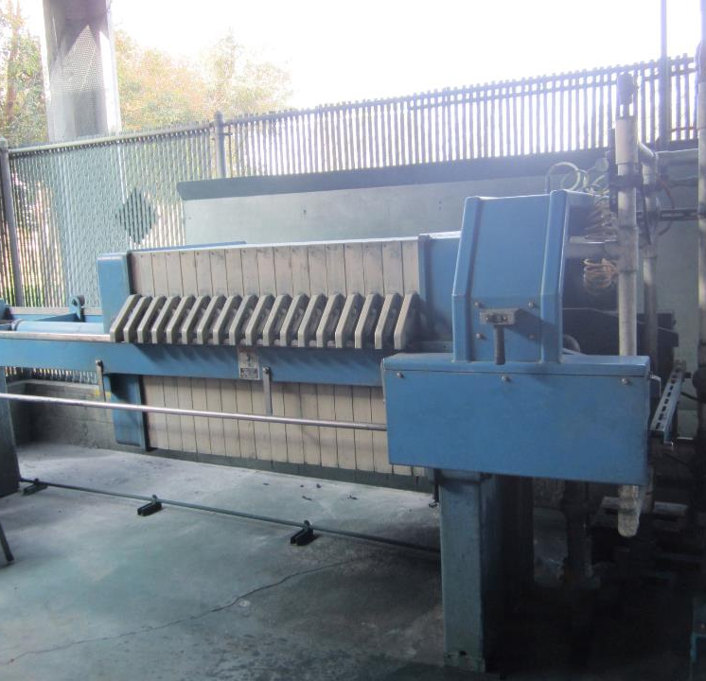
Wastewater Pretreatment Equipment

Slide 3
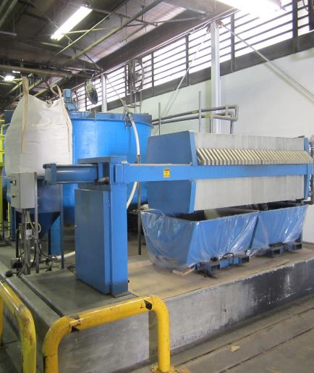
Batch Systems
500 to 7000 Gallons
  HMI/PLC Touch Screen Control Panel (UL Certified)
  Automated and Dependable
  Cone bottom tanks for best sludge removal and cleaning
  Designed to use MC Chemistry
  Provide installation and startup
  We train the operators

Slide 4
P & ID of our batch pretreatment system

Slide 5
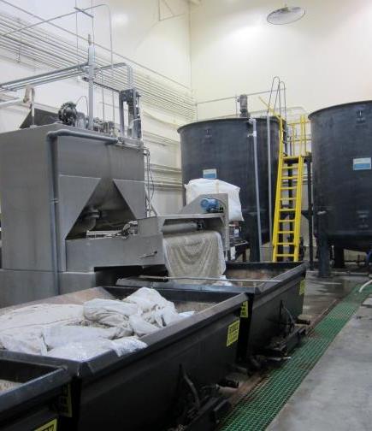
dewatering tables
Batch and Continuous Flow
  Delivered as a package
  Simple to operate
  Consistent
  Provide Installation and startup as an option
  Train the operators

Slide 6

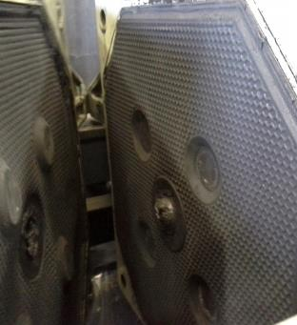
Filter Presses
  Best for sludge dewatering
  Provide Installation as an option

Slide 7
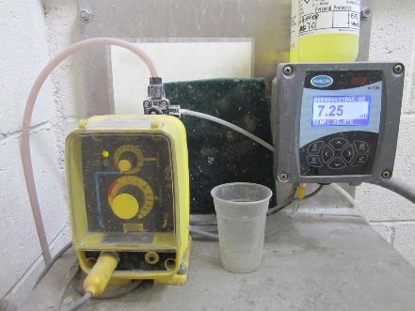
Ph control systems
  Adjust pH when needed
  Automated
  Very dependable
  Often used for pH adjusting treated water for reusing, wash down water, starch makeup within the corrugating industry

Slide 8
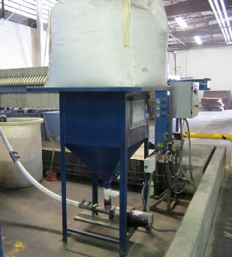
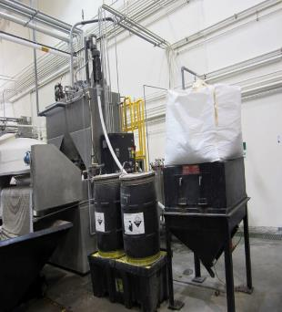
Super sack hoppers
  We provide 2 Optional Styles
  Holds 2000 lb. super sack of MC chemistry
  Eliminates handling 50 lb. bags

Slide 9
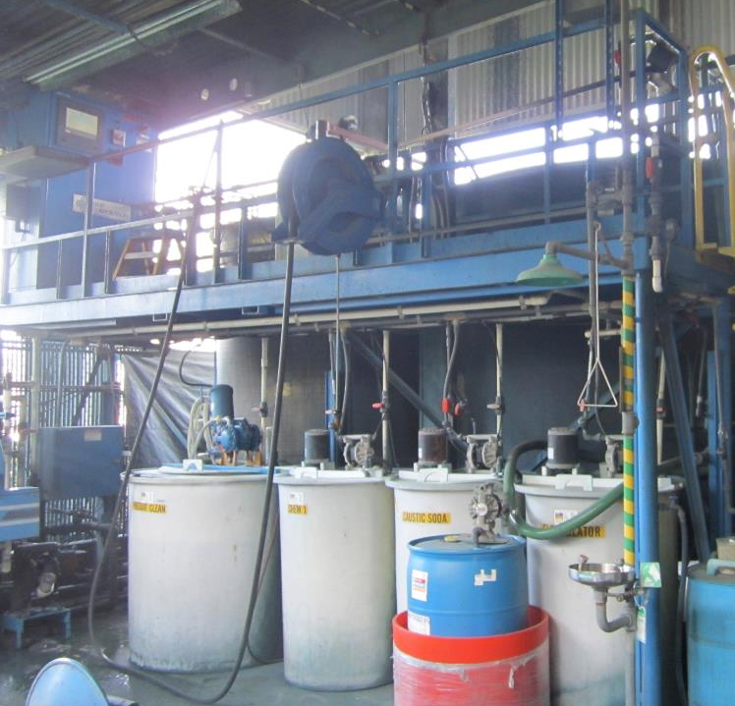
Wastewater pretreatment chemicals, showing the 3 or 4 liquid chemicals required

Slide 10
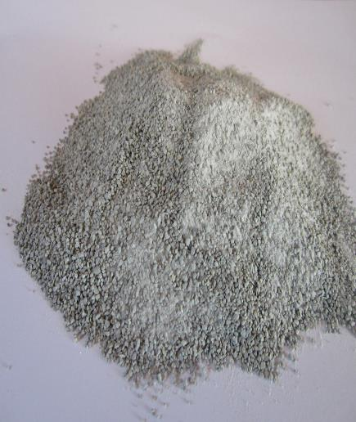
Bentonite Clay based blends
MC ###
  Non Hazardous
  Easy to use
  Replaces Liquid Chemistry
  Dewaters well
  MCI manufactures this product
  Custom blend if or when needed

Slide 11
Where we Fit in
Businesses we target
Industries we work in
  Facilities using liquid chemistry
  Facilities that are out of compliance
  Facilities wanting to evaluate their overall treatment cost wanting financial savings
  Corrugating/Converting
  Die Casting
  Metal Finishing
  Machining
  Paint Manufactures
  Textile
  Aerospace
  Auto Manufacturing
  Food Processing
  Refineries

Slide 12
pretreatment systems MC products work in
ALAR Environmental Rotary Vacuum Drum Systems
All Batch and Continuous Flow Dewatering Tables
Beckart Environmental Batch Systems
DMP Corporation Batch Systems
Walla Walla Environmental
Dissolved Air Flotation Systems (DAF’s)
Clarifiers
Among others

Slide 13
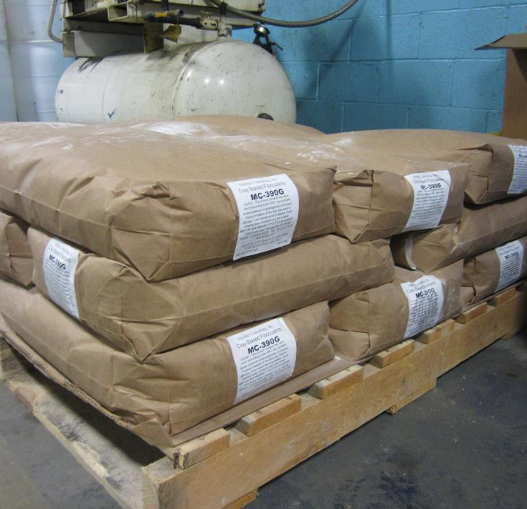
Benefits of mC chemistry

Slide 14
Benefits to the MC line of chemistry vs. liquid chemistry
  An average of 30 to 68% cost reduction per year
  One non – hazardous product versus three liquid chemicals in which two are considered hazardous
  Haul-off reduction in sludge weight/volume. Study conducted at 2 facilities.
  Eliminate multiple liquid chemical pumps and the possibility of injury from the hazardous chemicals when addressing repairs
  Eliminate the storage of used liquid drums and totes
  Eliminate the costs of handling the used drums and totes for either disposal or to have shipped back to vendor
  No capital costs to convert to MCI product
  Staff likes the simplicity of the single product
  Eliminate the use of Diatomaceous Earth (DE) for pre coating Filter Presses
  A consistent dry filter cake is obtained, meeting the landfil requirements for non-hazardous material
  Improved settling time with the sludge after treatment. This allows decanting water sooner increasing the hydraulics of the system
  Note: We do offer a line of liquid chemistry but have found for the reasons listed above, facilities prefer the dry bentonite clay based chemistry
  Note: We also provide chemicals and service for Boiler and Cooling Tower Treatment on the West Coast

Slide 15
Specialized Products for the Corrugating Industry
MC 1300 (AMA DP 35); this product is a biocide in 1 lb. soluble bags. It is used to control bacteria in starch batches and/or in water reuse systems where the treated water is used to make starch. Works well in wheat and corn starches. Contains NO VOC’s.
MC 1310 (HL Defoamer 10 - Liquid); this product is used to eliminate foam when required. It can be manually fed or set up with automated feed. Contains NO VOC’s. Provided in 55 gallon drums.
MC 1320 (HL H2S Reducer - Liquid); this product attacks the H2S which is the cause of odors, eliminating them within minutes. It can be manually fed, or set up with automated feed. The product does not have an odor. Best for sumps/pits/Holding Tanks. Contains NO VOC’s. Provided in 5 gallon pails, 55 gallon drums or 275 gallon totes. Most commonly used in 5 gallon pails.
MC 1330 (HL Odor Redux – Liquid); this product works the same as the MC 1320 product, but leaves a nice fresh scent. Provided in 5 gallon pails, 55 gallon drums or 275 gallon totes. Contains NO VOC’s. Most commonly used in 5 gallon pails.
MC 1340 (HL Starch Line Cleaner – Liquid); this product is used to clean starch batch tanks, starch lines and starch pans on the corrugator. It is applied to the batch tank, diluted with water, and recirculated. It can be manually fed (most common) or fed with automation. Works well with wheat and corn starches. Contains NO VOC’s. Provided in 5 gallon pails, 55 gallon drums or 275 gallon totes. Most commonly used in 5 gallon pails.
MC 1350 (HL Green X – Liquid); this product is used to control bacteria within wheat and corn starches. It can be fed manually but most customers prefer it to be fed with automation. This can be accomplished to interlock with main control panel to energize the feed pump controlled by a timer in order to have an accurate dosage per starch batch. Contains NO VOC’s and is considered Gras Approved. Provided in 55 gallon drums and/or 275 gallon totes.
MC 1360 (Formula 110 – Powder); this product is used to attack H2S to eliminate odors. It is provided in 1 lb. soluble bags, best applied manually to Holding Tanks, Treatment Tanks, and Water Reuse Tanks. Contains NO VOC’s.

